Slide 1

Lesson 10-2
Mapping Reducibility
Theory of Computation
王轩
Wang Xuan

Slide 2
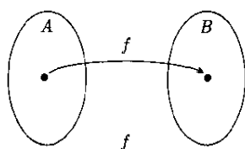
Mapping Reducibility
Reduce problem A to problem B by using a mapping reducibility means that a computation function exists that converts instances of A to instance of B.
We can solve A with a solver for B using the conversion function (reduction)
  Convert any instance of A to an instance of B
  Applying the solver for B

Slide 3
Computable functions
Definition: A function f: Σ*-> Σ* is a computable function if some Turing machine M, on every input w, halts with just f(w) on its tape.
Example
  All usual arithmetic operations on integers are computable functions. For example, a machine takes <m,n> as input and returns m+n.

Slide 4
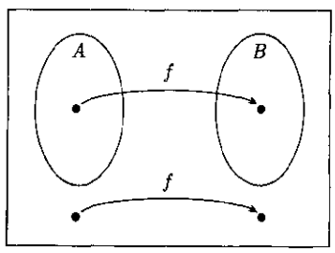
Formal Definition
Language A is mapping reducible to language B, written A ≤_{m}B, if there is a computable function f:Σ*->Σ* , where for every w,
w ∈ A <=> f(w) ∈B
The function f is called the reduction of A to B.
Mapping reducibility is transitive.

Slide 5
Membership Testing
Mapping reduction provides a way to convert membership testing in A to membership testing in B
  To testing whether w ∈A
  Use the reduction f to map w to f(w)
  Test whether f(w) ∈B
If problem A is mapping reducible to a solved problem B, we can obtains the solution of A.

Slide 6
Theorem
If A ≤_{m}B and B is decidable, then A is decidable.
Proof:
  Let M be the decider for B and f be the reduction from A to B. We describe a decider N for A as follow.
  N = “On input w:
    1. Compute f(w)
    2. Run M on input f(w) and output whatever M outputs.”
  If M accept f(w) => f(w)∈ B => w ∈A => N accept w;
  if M reject f(w) => f(w)∉B => w∉A => N reject w.

Slide 7
Corollary: If A ≤_{m}B and A is undecidable, then B is undecidable.
Example: HALT_{TM} is undecidable.
  Assume A=A_{TM}, B=HALT_{TM}
  Mapping reducible from A_{TM} to HALT_{TM}
  There is a computation function f that takes input of the form <M,w> and return output of the form <M’,w’>, where

Slide 8
The following machine F computes a reduction f.
F = “On input <M,w>:
  1. Construct the following machine M’.
    M’=“On input x:
      1. Run M on x.
      2. If M accepts, accept.
      3. If M rejects, enter a loop.”
  2. Output <M’,w>.”

Slide 9
a. If <M,w>∈A_{TM} ⇒ M accepts w ⇒ M’ halts ⇒ <M’,w> ∈HALT_{TM}
b. If <M,w>∉A_{TM} ⇒ M doesn’t accept w ⇒ M’ enter a loop ⇒ <M’,w> ∉ HALT_{TM}

Slide 10
Others
Post corresponding problem (PCP)
  A_{TM} ≤_{m}MPCP, MPCP ≤_{m}PCP
  Mapping reducibility is transitive
  A_{TM} ≤_{m}PCP
E_{TM} ≤ EQ_{TM}

Slide 11
If A ≤_{m}B and B is Turing-recognizable, then A is Turing-recognizable. (same as before)
If A ≤_{m}B and A is not Turing-recognizable, then B is not Turing-recognizable.
A ≤_{m}B A ≤_{m}B
(w ∈ A w ∉A f(w) ∉B f(w) ∈ B )

Slide 12
Theorem
EQ_{TM} is neither Turing-recognizable nor co-Turing-recognizable.
1. Prove EQ_{TM} is not Turing-recognizable.
We reducing A_{TM} to EQ_{TM.}
A_{TM} ≤_{m} EQ_{TM} ⇔ A_{TM} ≤_{m} EQ_{TM}
Since A_{TM} is not Turing-recognizable, EQ_{TM} is not Turing-recognizable.

Slide 13
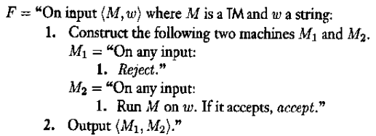
The reduction function f works as follows.
<M₁,M₂>∈EQ_{TM} ⇒ L(M₁)=L(M₂) ⇒ L(M₂)=∅ ⇒ M doesn’t accept w.
<M₁,M₂>∉EQ_{TM} ⇒ L(M₁)≠L(M₂) ⇒ L(M₂) ≠∅ ⇒ M accepts w.

Slide 14
2.Prove EQ_{TM} is not co-Turing-recognizable we need to reducing A_{TM} to the complement of EQ_{TM}, EQ_{TM}. Thus to prove A_{TM} ≤_{m} EQ_{TM.}
A_{TM} ≤_{m} EQ_{TM} ⇔ A_{TM} ≤_{m} EQ_{TM}
Since A_{TM} is not Turing-recognizable, EQ_{TM} is not Turing-recognizable, so EQ_{TM} is not co-Turing-recognizable.

Slide 15
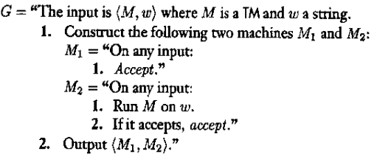
The reduction function g is
<M₁,M₂>∈EQ_{TM} ⇒ L(M₁)=L(M₂) ⇒ M accepts w ⇒<M,w>∈ A_{TM}
<M₁,M₂>∉EQ_{TM} ⇒ L(M₁)≠L(M₂) ⇒ M doesn’t accept w ⇒<M,w> ∉A_{TM}
A_{TM} ≤_{m} EQ_{TM}

